Slide 1
UNIVERSITY INSTITUTE OF COMPUTING
MASTER OF COMPUTER APPLICATIONS
Design and Analysis of Algorithms
24CAT-611
UNIT-3
DISCOVER . LEARN . EMPOWER

Slide 2
Multi-Stage Graph
• A Multistage graph is a directed graph.
• The nodes can be divided into a set of stages.
• All edges from a stage to next stage .
• There is no edge between vertices of same stage .
• A vertex of current stage to previous stage
• A multistage graph, a source and a destination, we
need to find shortest path from source to destination.

Slide 3
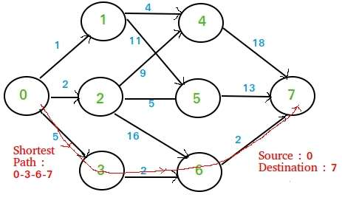
Multistage Graph

Slide 4
VARIOUS STRATEGIES
: The Brute force method of finding all possible
paths between Source and Destination.
• Dijkstra’s Algorithm has a Single Source shortest
paths.
• This method will find shortest paths from source
to all other nodes which is not required.
• It will take a lot of time and it doesn’t even use the
SPECIAL feature that this MULTI-STAGE graph.

Slide 5
Simple Greedy Method
At each node, choose the shortest outgoing path.
• we apply this approach to the example graph give
above we get the solution as 1 + 4 + 18 = 23.
• But a quick look at the graph will show much
shorter paths available than 23. So the greedy
method fails.
• The best option is Dynamic Programming.
• To find Optimal Sub-structure, Recursive
Equations and Overlapping Sub-problems.

Slide 6
BASIC TRAVERSAL AND SEARCH TECHNIQUES
• Traversal of a binary tree involves examining
every node in the tree.
• Search involves visiting nodes in a graph in a
systematic manner, and may or may not result into
a visit to all nodes.
• Different nodes of a graph may be visited,
possibly more than once, during traversal or
search.
• If search results into a visit to all the vertices, it is
called traversal.

Slide 7
TECHNIQUES FOR BINARY TREES
Determine a vertex or a subset of vertices that satisfy a specifified property .
Possible problem:
Find all nodes in a binary tree with data value less than some specified value .
Solved by systematically examining all the vertices
Does searching for a specifified item in a binary search tree result into a traversal.

Slide 8
TECHNIQUES FOR GRAPHS
Reachability problem in graph theory.
• Determine whether a vertex v is reachable from a vertex u in a graph G = (V,E).
• Whether there exists a path from u to v.
• A more general form:
• Given a vertex u ∈ V , find all vertices vi ∈ V such that there is a path from u to vi.
• Solved by starting at vertex u and systematically searching the graph G for vertices reachable from u.
• Breadth first search and traversal

Slide 9
TECHNIQUES FOR GRAPHS
Explore all vertices adjacent from a starting vertex.
A vertex is said to be explored when the algorithm has visited all the vertices adjacent from it.
As a vertex is reached or visited, it becomes a new unexplored vertex.
Explore unexplored vertices that are adjacent to all the explored vertices.
Breadth-first search operates using a queue to maintain the list of unexplored vertices.

Slide 10
1) https://www.tutorialspoint.com/data_structures_algorithms/divide_and_conquer.htm 2) Data Structures and Algorithms made easy By Narasimha Karumanchi. 3) The Algorithm Design Manual, 2nd Edition by Steven S Skiena 4) Fundamentals of Computer Algorithms - Horowitz and Sahani
References

Slide 11
THANK YOU

